Slide 1

A Project Review Meeting on Airline_Ops_Briefing_Dashboard
By
Name: A. Kavya Sree roll: 2520090143
Name: Bhavagna roll: 2520030062
Team Number: 1
Under the guidance of
Ms. D. Pavitra
Assistant professor
Department of Computer Science and Engineering
Koneru Lakshmaiah Education Foundation (Deemed to be University estd. u/s. 3 of the UGC Act, 1956) Off-Campus: Bachupally-Gandimaisamma Road, Bowrampet, Hyderabad, Telangana - 500 043. Phone No: 7815926816, www.klh.edu.in

Slide 2
Abstract
Airline operations involve managing multiple activities such as flight scheduling, slot allocation, delay monitoring, staff coordination, weather tracking, and gate management. Handling these activities manually can lead to operational inefficiencies, delays, and poor decision-making. To address these challenges, we developed AeroOps Command – Airline Operations Briefing Dashboard, a web-based application designed to provide airport managers with a centralized platform for monitoring daily airport operations.
The dashboard presents real-time operational insights through various modules including KPI Summary, Slot Utilization Analysis, Delay Heatmap, Weather Monitoring, Staff Management, Gate Conflict Alerts, Flight Departure Board, Notifications, Export Briefing, and Admin Controls. The system enables users to visualize critical airport data, identify operational bottlenecks, monitor flight delays, and respond quickly to conflicts affecting airport efficiency. The application is developed using React.js, TypeScript, HTML5, CSS3, and JavaScript (ES6+), following a component-based architecture and modern front-end engineering principles. Features such as dynamic data generation, interactive dashboards, responsive design, and state management provide an efficient user experience. The system also supports date-based operational analysis, allowing users to view different airport scenarios for different days.
The proposed solution improves operational awareness, supports data-driven decision-making, enhances resource utilization, and provides a scalable foundation for future integration with real-time airline and airport management systems.

Slide 3
Introduction
The aviation industry relies heavily on efficient operational management to ensure smooth airport functioning, passenger satisfaction, and flight safety. Every day, airport managers must monitor multiple operational factors such as flight schedules, slot utilization, delays, weather conditions, gate assignments, and staff availability. Managing this information through separate systems can be time-consuming and may lead to delayed decision-making during critical situations.
To address these challenges, the AeroOps Command – Airline Operations Briefing Dashboard has been developed as a centralized web-based platform for airport operations management. The system provides a comprehensive operational overview by integrating key airport metrics and visualizations into a single dashboard. It enables airport managers to monitor flight activities, analyze delays, track slot utilization, identify gate conflicts, manage staff resources, and review weather conditions in real time.
The dashboard is designed using modern front-end technologies including React.js, TypeScript, HTML5, CSS3, and JavaScript. It follows a component-based architecture that improves maintainability, scalability, and user experience. Interactive charts, dynamic KPI cards, heatmaps, notification systems, and administrative controls help users quickly identify operational issues and make informed decisions.
The project aims to improve operational efficiency, enhance situational awareness, and support data-driven management within airport environments. By providing a unified operational briefing platform, AeroOps Command demonstrates how modern web technologies can be applied to solve real-world challenges in the airline and airport management domain.

Slide 4
Problem Statement
Airports handle a large number of daily operations, including flight scheduling, slot allocation, gate management, staff coordination, delay monitoring, and weather assessment. These operational activities generate significant amounts of data that must be monitored continuously to ensure smooth airport functioning. However, information is often distributed across multiple systems, making it difficult for airport managers to obtain a unified view of ongoing operations.
The absence of a centralized monitoring platform can lead to delayed decision-making, inefficient resource utilization, increased flight delays, gate conflicts, staffing issues, and reduced operational efficiency. Airport managers require a system that can consolidate critical operational information and present it in an easy-to-understand format for rapid analysis and response.
To address this challenge, there is a need for a web-based Airport Operations Briefing Dashboard that integrates key operational metrics such as flight status, slot utilization, delay analysis, weather conditions, staffing information, gate conflict alerts, and administrative controls into a single platform. The system should provide real-time insights, interactive visualizations, notifications, and reporting capabilities to support efficient airport management and improve overall operational performance.
The proposed solution, AeroOps Command – Airline Operations Briefing Dashboard, aims to provide airport managers with a centralized, user-friendly, and data-driven platform for monitoring and managing daily airport operations effectively.

Slide 5
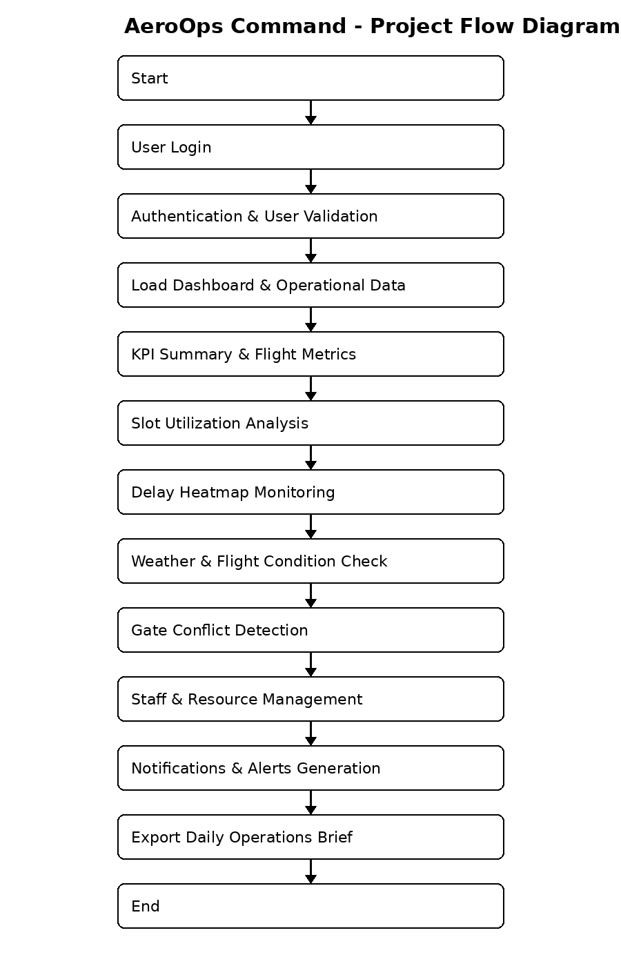
Project Flow Diagram

Slide 6
Objectives with Justification
1. To develop a centralized airport operations dashboard.
Justification: A centralized platform allows airport managers to monitor all critical operational information from a single interface, improving efficiency and decision-making.
2. To monitor flight operations and delays in real time.
Justification: Real-time tracking of flights and delays helps identify operational issues quickly and supports timely corrective actions.
3. To analyze airport slot utilization and resource allocation.
Justification: Efficient slot management reduces congestion, improves airport capacity utilization, and supports smooth flight operations.
4. To detect and manage gate conflicts effectively.
Justification: Early detection of gate conflicts minimizes operational disruptions and helps maintain scheduled flight movements.
5. To provide operational alerts, reports, and decision-support information.
Justification: Notifications, alerts, and exportable reports enable airport managers to respond quickly to issues and make data-driven decisions.

Slide 7
Modules [Frontend web pages]
Module | Description
Login Page | User authentication and secure access
Dashboard Page | Displays KPI summaries and airport overview
Slot Utilization Page | Monitors airport slot allocation
Delay Analysis Page | Shows flight delay heatmaps
Flight Operations Page | Displays flight schedules and status
Weather Monitoring Page | Shows weather information
Gate Conflict Page | Detects gate assignment conflicts
Staff Management Page | Manages staff schedules and availability
Notifications Page | Displays alerts and operational updates
Admin Panel | System settings and configuration
Export Reports Page | Generates operational reports

Slide 8
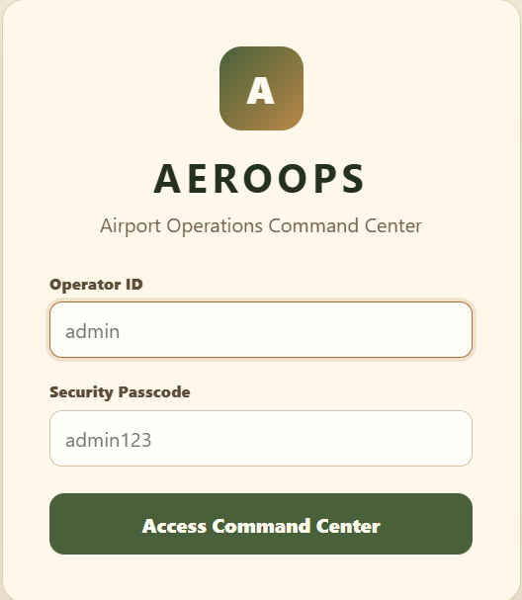
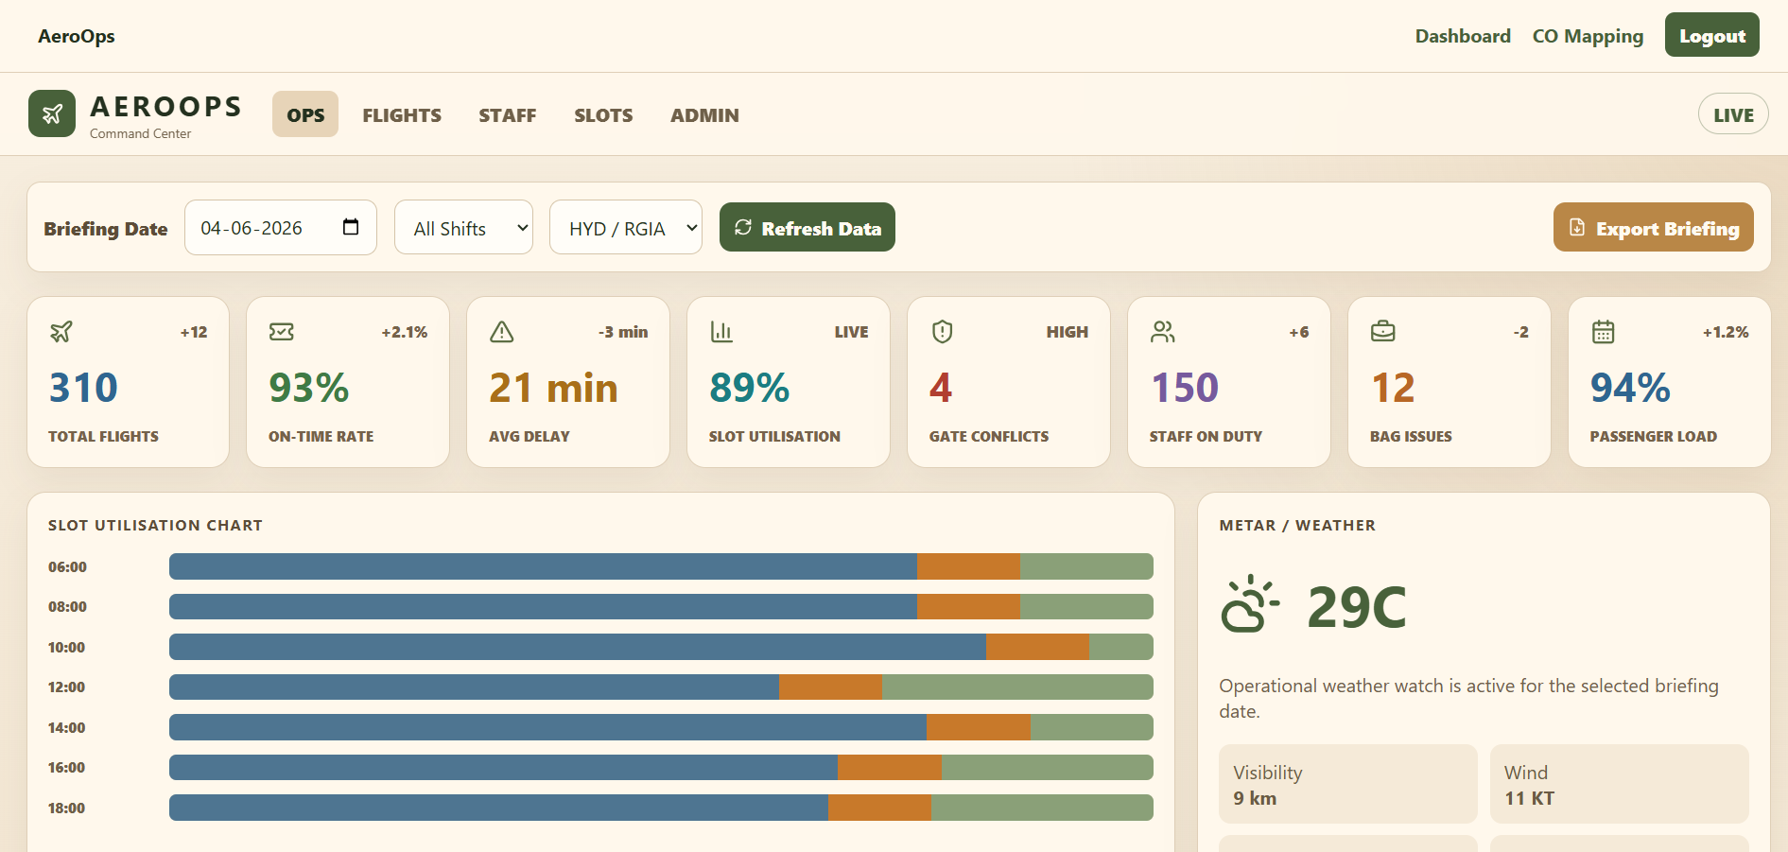
Expected Outcomes of the Proposed Work

Slide 9
Conclusion and Future Scope
The AeroOps Command – Airline Operations Briefing Dashboard was developed to provide a centralized platform for monitoring and managing airport operations. The system integrates key operational modules such as flight monitoring, slot utilization analysis, delay tracking, weather monitoring, gate conflict detection, staff management, notifications, and reporting. By presenting operational data through an interactive and user-friendly dashboard, the system helps airport managers improve decision-making, resource utilization, and operational efficiency. The project demonstrates the effective use of modern front-end technologies to address real-world challenges in the airline and airport management domain.

Slide 10
References
React.js Documentation. Available at: https://react.dev/
TypeScript Documentation. Available at: https://www.typescriptlang.org/docs/
Vite Documentation. Available at: https://vitejs.dev/
MDN Web Docs – HTML, CSS and JavaScript. Available at: https://developer.mozilla.org/
React Router Documentation. Available at: https://reactrouter.com/
Tailwind CSS Documentation. Available at: https://tailwindcss.com/docs
Axios Documentation. Available at: https://axios-http.com/docs/intro
OpenWeather API Documentation. Available at: https://openweathermap.org/api
Federal Aviation Administration (FAA). Airport Operations Guidelines. Available at: https://www.faa.gov/
International Air Transport Association (IATA). Airport and Airline Operations Resources. Available at: https://www.iata.org/

Slide 11
Thank you

